Slide 1
Chapter 7: Multicarrier Modulation

Slide 2
Introduction
Motivations
Diagonalization of Vector Channels
Transmission of one OFDM Symbol
Transmission of sequence of OFDM Symbols
Sample and Symbol Time Synchronization
Carrier Frequency Synchronization
Peak-to-Average Power Ratio (PAPR) Issue

Slide 3

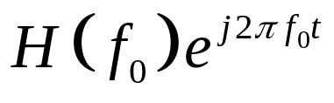
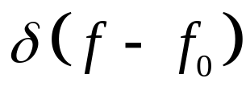
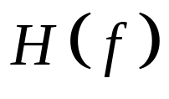
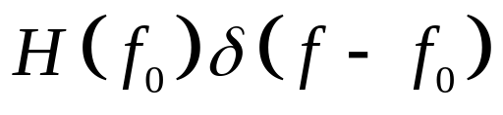
OFDM: Basic Concept
Both the single-carrier system with ISI equalization and the DS spread-spectrum system with Rake reception are based on a time-domain view of the channel.
Complex sinusoids are the only eigenfunctions of linear time-invariant channels.
Most wireless channels are underspread
  delay spread << coherence time
Can be approximated by a linear time invariant channel over a long time scale.
LTI Channel
Complex
sinusoids

Slide 4
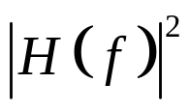

OFDM: Motivations
f₁
f₂
f₃
f₄
f
Treat a Wideband FS fading channel as Multiple Narrowband Flat fading channels.
Change in TX so that RX does not suffer from ISI.
Use FEC with codeword span across all sub-channels achieve Frequency Diversity, but with no ISI problem.

Slide 5
Multicarrier Modulation
R/N bps
QAM
Modulator
x
R bps
Serial
To
Parallel
Converter
cos(2πf₀t)
Σ
R/N bps
QAM
Modulator
x
cos(2πf_{N}t)
Breaks data into N substreams
Substream modulated onto separate carriers
  Substream bandwidth is B/N for B total bandwidth
  B/N<B_{c} implies flat fading on each subcarrier (no ISI)

Slide 6
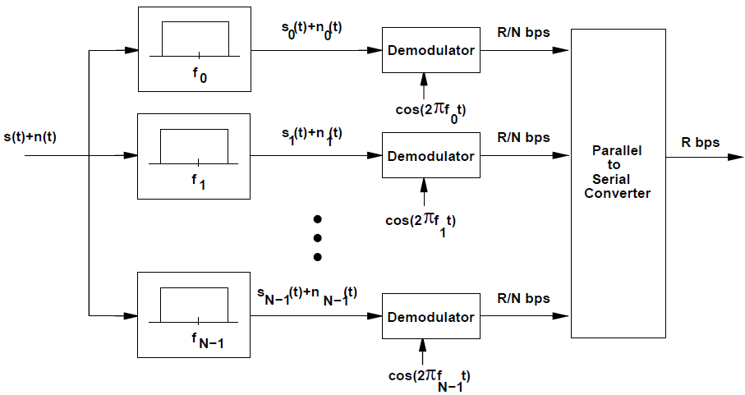
Multicarrier receiver

Slide 7





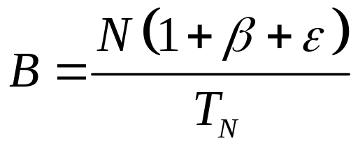
Multicarrier Modulation
guard band
Problems:
  Multiple transmitter front ends (mixer, modulator, etc)
  require guard bands
Solutions:
  Use DFT to create the baseband equivalent of the transmit signal and then up-covert it to the center frequency using one front end
  As DFT is an orthogonal transformation, no guard band is needed

Slide 8
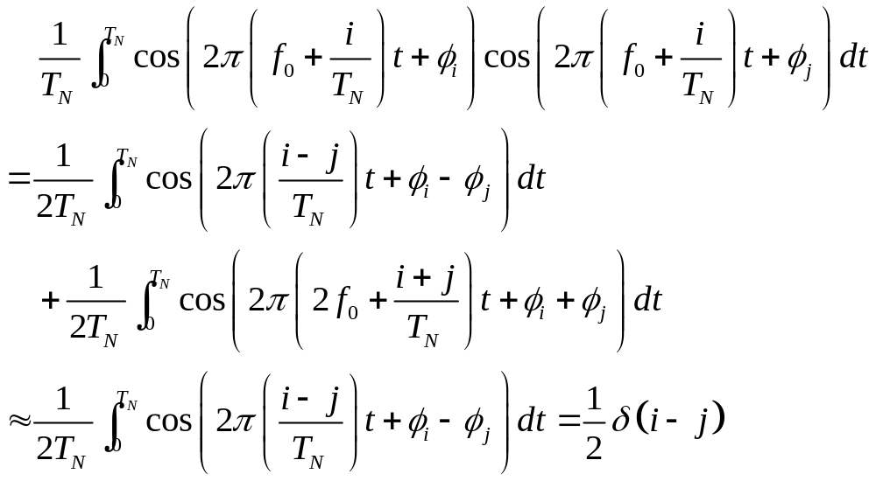
Multicarrier modulation with overlapping subchannels
Improve the spectral efficiency of multicarrier modulation by overlappng the subchannels

Slide 9
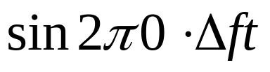
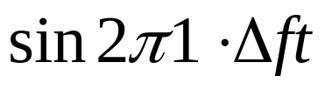
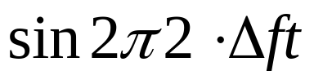
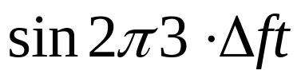
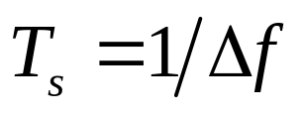
Orthogonal Condition —— Example

Slide 10
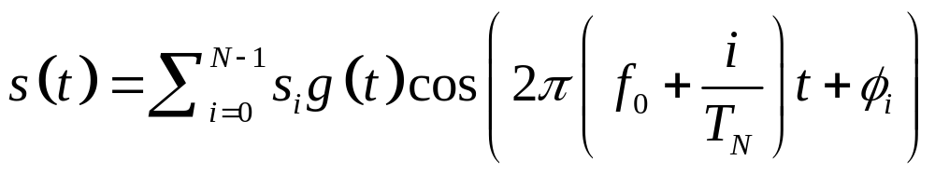
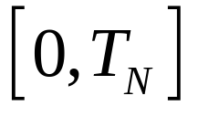
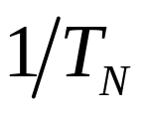
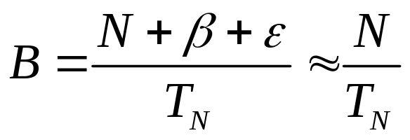
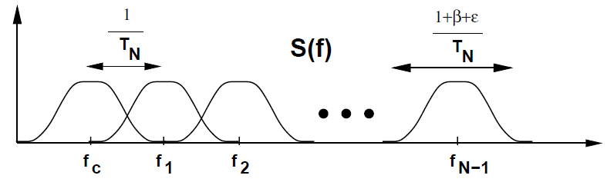
Orthogonal Condition
The transmitted signal is
The minimum frequency separation required for subcarriers to remain orthogonal over the symbol interval is .
The total frequency bandwidth is

Slide 11
Fading Across Subcarriers
Leads to different BERS
Compensation techniques
  Frequency equalization (noise enhancement)
  Precoding
  Coding across subcarriers
  Adaptive loading (power and rate)

Slide 12
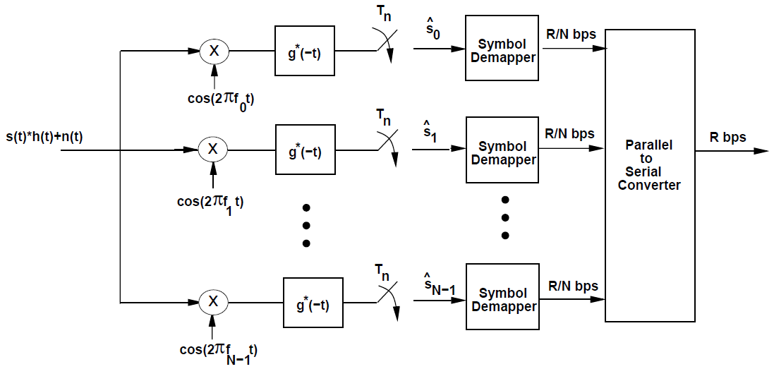
Multicarrier receiver for overlapping subcarriers

Slide 13
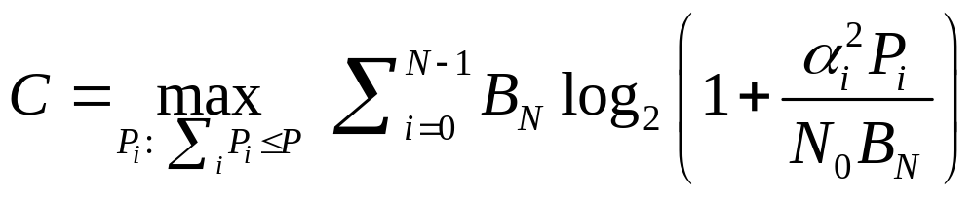
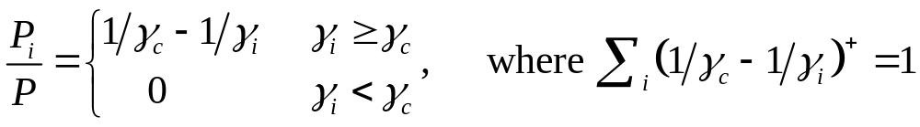
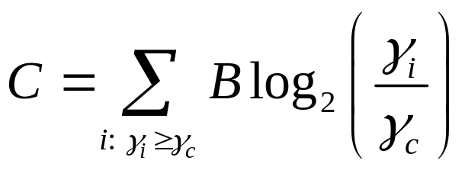
Adaptive loading
The capacity of this parallel set of channels is
The optimal solution is water-filling in the frequency domain
The capacity

Slide 14
Two Key Points in OFDM
DFT operation for multicarrier modulation
Cyclic prefix (CP)

Slide 15


Multicarrier Modulation
Split a frequency selective fading channel into multiple, say N=64, narrowband flat fading sub-channels
Send the bits over these sub-channels in parallel
modulator
Mixer
Serial
to
Parallel
Com-
biner
modulator
Mixer

Slide 16
FFT Implementation of OFDM
Efficient IFFT structure at transmitter
  Reverse structure (with FFT) at receiver
  Cyclic prefix makes linear convolution circular, so there is no interference between input blocks
Issues
  Timing/frequency offset impacts subcarrier orthogonality
  Adding signals creates large signal peaks (large PAPR)
  Fading across subcarriers impacts performance
X₀
x₀
R bps
Serial
To
Parallel
Converter
Add cyclic
prefix and
Parallel
To Serial
Convert
QAM
Modulator
D/A
x
IFFT
X_{N-1}
x_{N-1}
cos(2πf_{c}t)

Slide 17
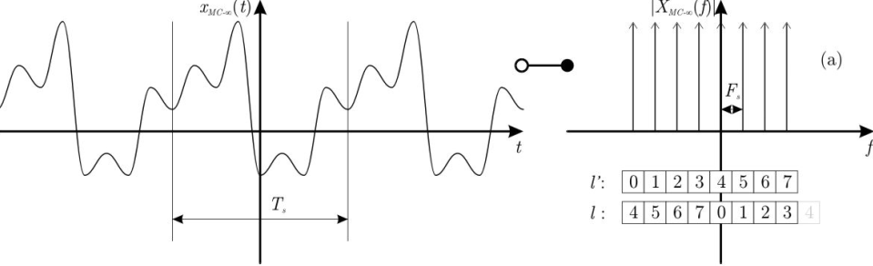
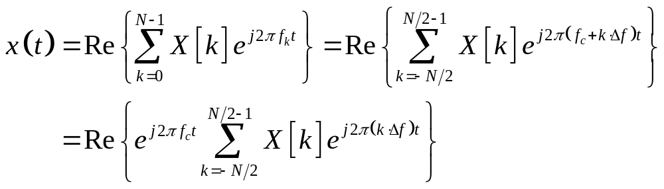
Modulation via DFT in OFDM (1)

Slide 18
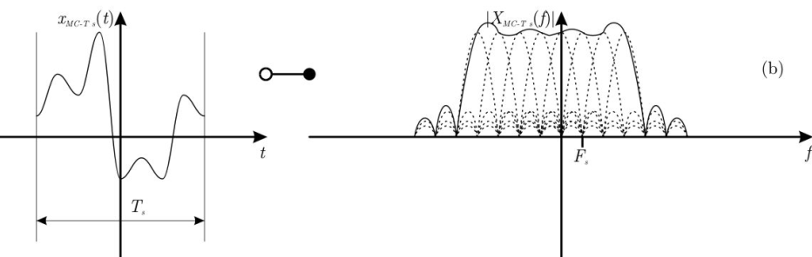
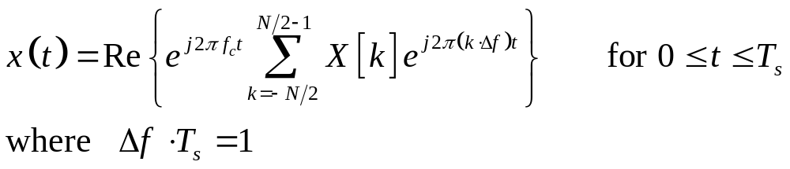
Modulation via DFT in OFDM (2)

Slide 19
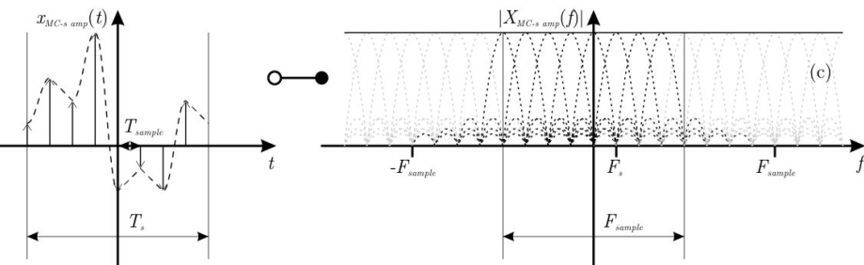
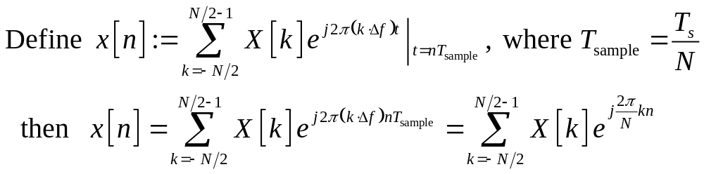
Modulation via DFT in OFDM (3)

Slide 20
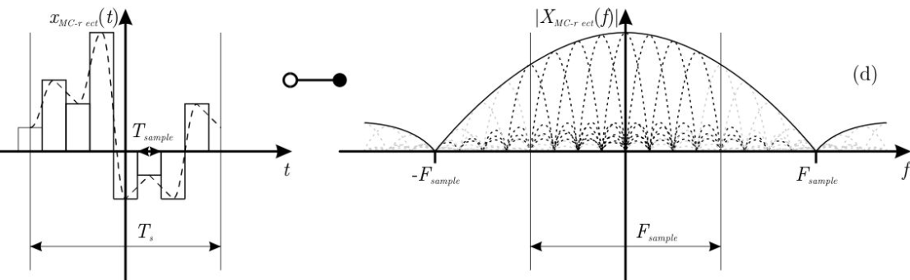
Modulation via DFT in OFDM (4)
Recovering from discrete signal to continuous signal

Slide 21

Cyclic prefix (CP)
Repeat the last part of a data block in front of that block
The functions of CP, when the length is larger than the channel delay.
  Avoid inter-block interference
  Make linear convolution to cyclic convolution (circular convolution)

Slide 22
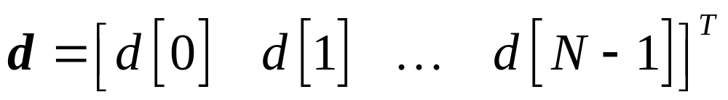
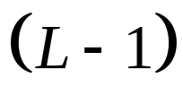
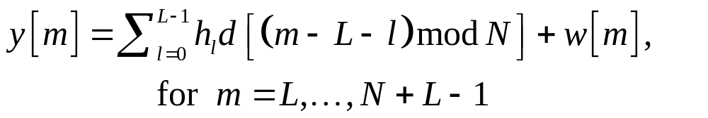
Cyclic Prefix (CP)
Original data packet is
After CP insertion
Received signal
Dropping the first L samples
length CP

Slide 23

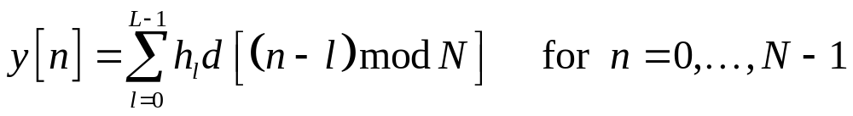

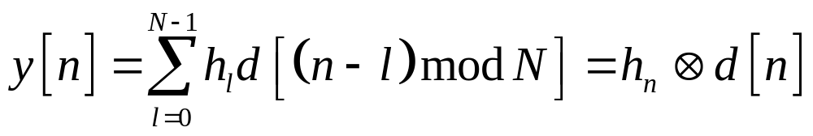
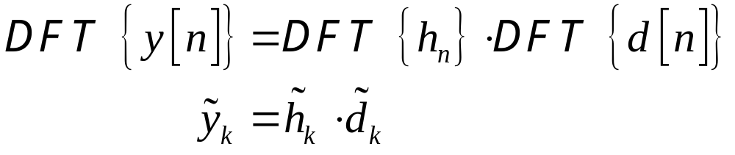
Property of Circular Convolution
Define
Normally
Then, we have

Slide 24
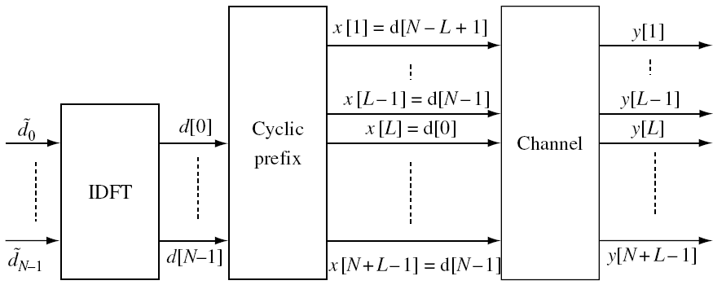
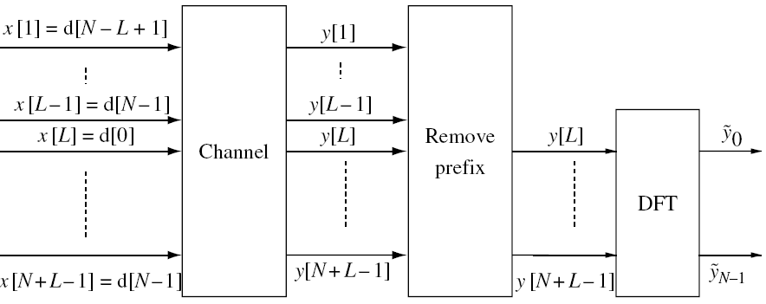
OFDM – the Whole System Diagram
TX side
RX side

Slide 25
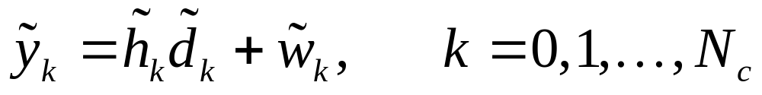
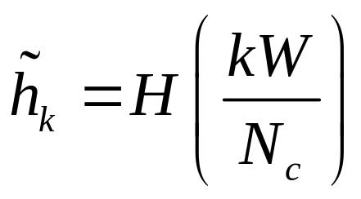
OFDM
OFDM transforms the communication problem into the frequency domain:
A bunch of non-interfering sub-channels, one for each sub-carrier.
Can apply time-diversity techniques

Slide 26
Cyclic Prefix Overhead
OFDM overhead
= length of cyclic prefix / OFDM symbol time
Cyclic prefix dictated by delay spread.
OFDM symbol time limited by channel coherence time.
Equivalently, the inter-carrier spacing should be much larger than the Doppler spread.
Since most channels are underspread, the overhead can be made small.

Slide 27
Example: Flash OFDM (Flarion)
Bandwidth = 1.25 Mz
OFDM symbol = 128 samples = 100 μ s
Cyclic prefix = 16 samples = 11 μ s delay spread
11 % overhead.

Slide 28
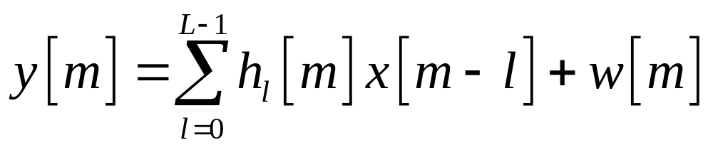
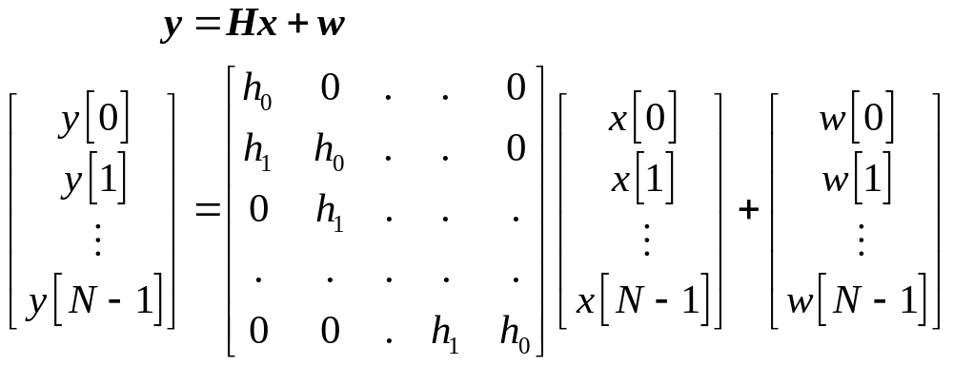
Another Look —— Vector Channels
Received signal

Slide 29
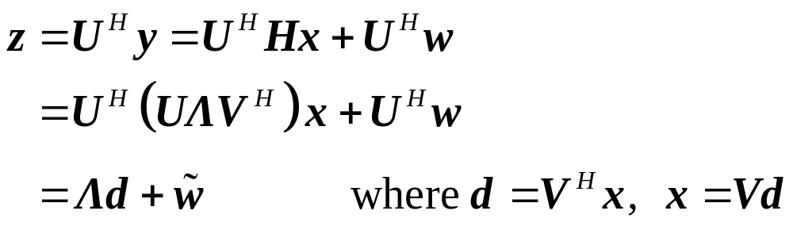












Diagonalization of Vector Channels
We would like to diagonalize the channel such that

Slide 30

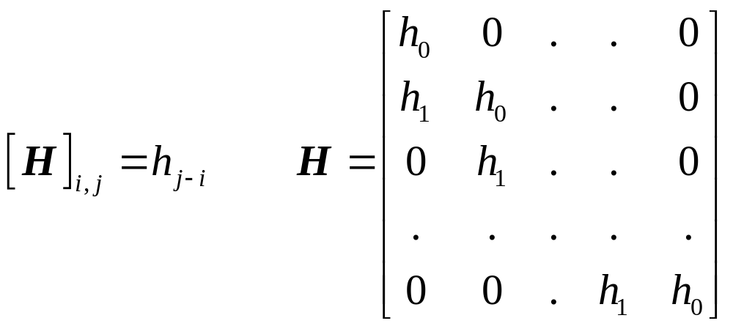

Toeplitz Matrix
For channel is ISI, is Toeplitz

Slide 31

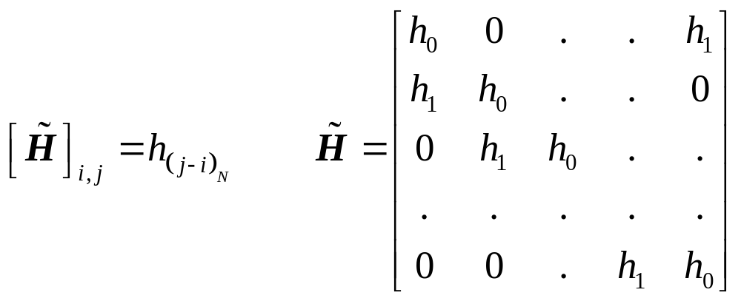
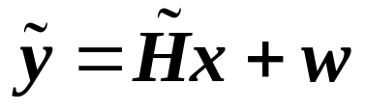
Circulant Matrix
is a circulant matrix if

Slide 32


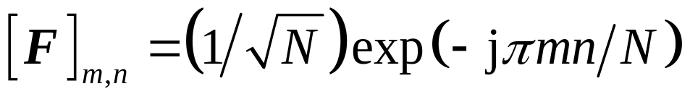
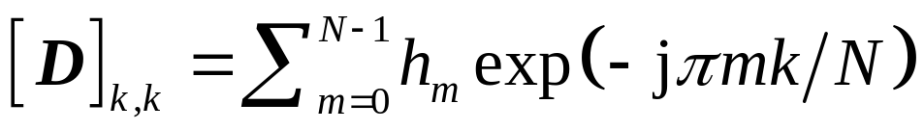

Diagonization of Circulant Matrix
If is circulant, then
  where is the normalized DFT matrix.
  where , which is the DFT of the channel impulse response: Gains of the subchannels.
Note that THE that diagonalized is independent of !
  Hence, TX does not need to know !!
Use cyclic prefix to create an effective circulant matrix

Slide 33
Summary
Multicarrier modulation and OFDM
OFDM
  Motivation
  Modulation via DFT in OFDM
  The advantage of CP

